Slide 1

Book : Intelligent Fault Diagnosis and Remaining Useful Life Prediction of Rotating Machinery
Introduction and background
Muhammad Umar
Graduate Research Assistant
Ulsan Industrial Artificial Intelligence Laboratory

Slide 2
Table of contents
Common Rotating Machinery Components
Health Management Strategies
Overview of Prognostic and Health Management (PHM)

Slide 3
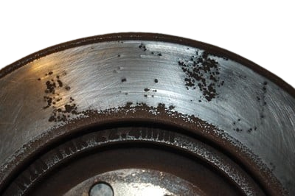
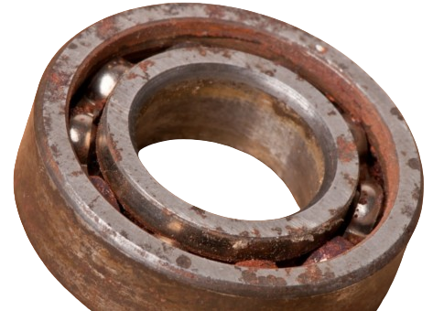
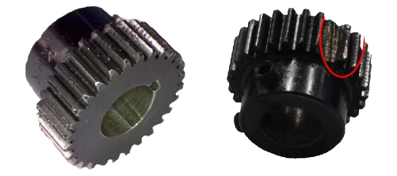
Common Rotating Machinery Components
Rotating Machinery Component
Common Faults
Visuals
Rotors
Spinning discs or wheels that transmit power
Mass unbalance, Bent, Rub, Misalignment, Resonance
Rolling Elements Bearings
Components that allow smooth rotation with minimal friction
Flaking, Spalling, Peeling, Abrasion, Corrosion
Gears
Toothed wheels that mesh to transmit torque and change speed or direction.
Broken teeth, Wear, Misalignment

Slide 4


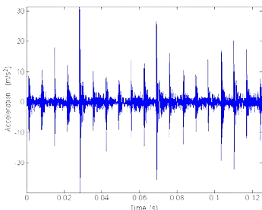
Health management strategies
Health Management Strategies
Reactive
Maintenance
Preventive
Maintenance
Predictive
Maintenance
Run-to-failure
Traditional maintenance strategy
Time-Based
Machine are repeatedly checked
Condition-Based
Recommend maintenance based on information

Slide 5
ADVANTAGES AND DISADVANTAGES
Strategy | Advantages | Disadvantages
Reactive Maintenance | Large operation time before failure | Result in severe damage or accidents
Preventive Maintenance | Reduce Downtime, Increase lifespan | costly
Predictive Maintenance | Cost savings, increased safety and efficiency | High initial cost
Table: Health Management Strategies

Slide 6

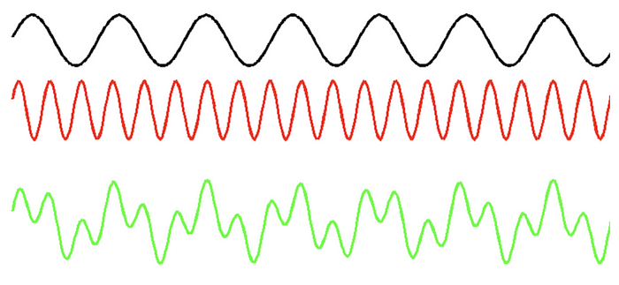
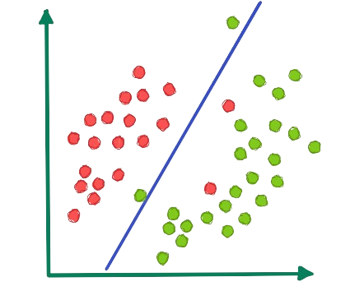

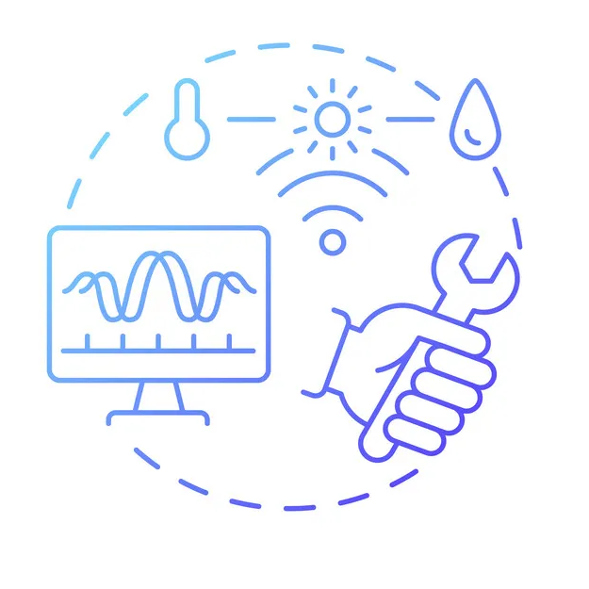
Overview of PHM
Data Acquisition
Signal Processing
Diagnosis
Prognosis
Maintenance Decision

Slide 7
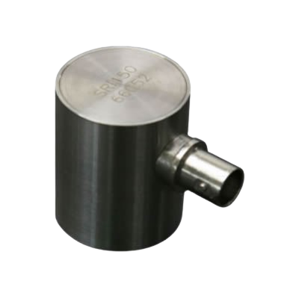


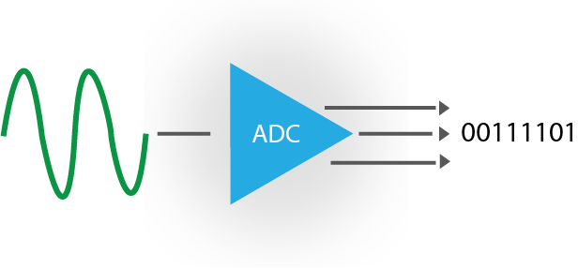
Data acquisition
AE Sensor
ADC
Storage
Analysis

Slide 8



Diagnosis
Determining the relationship b/w measure information and machine fault patterns.
Three major steps
Fault Detection
Did something go wrong?
Indicate whether fault has occurred or not.
Fault Isolation
Where is the problem happening?
Find fault component and position.
Fault Identification
What exactly is broken?
Determine pattern, size, type, its severity.

Slide 9
Prognosis
Detect fault presence and identify trends, and degree.
Forecast future performance of machinery.
State Estimation
State estimation reveals hidden health (internal parameters)
State Degradation
State degradation tracks its decline (graph)
RUL Prediction
RUL prediction estimates time till failure.

Slide 10
Cont...
Prognostics
Data Driven Method
Rely on historical measurements and statistical data
Model Based Method
Use mathematical or physical method to describe degradation.
Data-Model Fusion
Integrate both methods, aim for more reliable RUL prediction

Slide 11

5. Maintenance Decision
Final process in PHM.
Determine optimal maintenance strategies.
Ensure effective assets management, minimize downtime.
E-maintenance, e-monitoring, e-diagnosis, e-prognosis.

Slide 12

Thank you

